Slide 1

From Checkout to Forecast:
A Retail Data Deep Dive
Dido De Boodt
June 2025
Notes:
Welcome everyone!
My name is Dido, and today I’ll walk you through a retail forecasting project I developed.
The goal was to predict daily unit sales using machine learning, and build an interactive forecasting app to support demand planning.

Slide 2


Project Overview
Dataset
Ecuadorian retailer with over 120 million rows.
02
Business Goal
Improve stock and promo planning by predicting sales per store-item-date
01
03
Focus
Guayas region and top 3 item families
Notes:
The main business goal is to improve stock and promotion planning by forecasting sales per store–item–date combination.
This project was inspired by a real-world dataset from an Ecuadorian grocery chain.
I focused on a manageable region—Guayas—and the top 3 item families to streamline training and evaluation.

Slide 3
Project Steps
Data Preparation
Features
EDA
Models
App
Missing values and dates
Outliers and anomalies
Lags
Rolling Windows
Time based Features
Time Series Behavior Analysis
Seasonal, holiday, promotion, oil, store and location
XGBoost
LSTM
ARIMA and SARIMA
Streamlit App Deployment
Live Forecast Output
10-Day Forecast and download
Notes:
Let me walk you through the workflow of this project, step by step.
We started with data preparation, where I handled missing values, date inconsistencies, outliers, and anomalies to ensure data quality.
Next, I created time-based features like is_weekend, is_holiday, and several lag and rolling window features. These are crucial for helping machine learning models understand temporal dependencies in the data.
During the exploratory data analysis, I explored time series behavior by examining trends, seasonality, stationarity, and autocorrelation. I also looked into the impact of holidays, promotions, store locations, and even oil prices on sales patterns.
Then came modeling: I trained and tuned three types of models—
a tree-based model: XGBoost,
a deep learning model: LSTM,
and classical time series models: ARIMA and SARIMA
Finally, I deployed a Streamlit app that provides live forecasts per store-item-date combination and allows users to download a 10-day prediction.

Slide 4
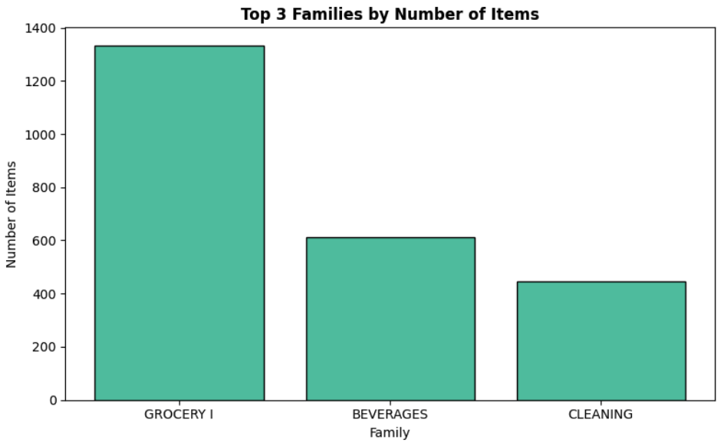
About the Data
Key Steps
Merged: items, stores, and holidays
Cleaned missing values & outliers
Created lag, rolling avg, calendar features
Shape: 3.39M rows × 41 cols
Date range: Jan 2013 – Mar 2014
Stores: 10
Items: 1,127
Avg daily sales: 3.97
Zero sales: 47.25%
Notes:
I worked with over 3 million rows covering holidays, and metadata about stores and items.
The top 3 families in terms of item count were Grocery I, Beverages, and Cleaning—so these became my forecasting focus.
Around 47% of the data had zero sales, which presented a challenge for modeling.

Slide 5
From Patterns to Predictions
RMSE 7.77
RMSE 7.80
RMSE 7.88
XGBoost
LSTM
SARIMA
XGBoost performs well on large-scale tabular time series data, especially when engineered features include lag and rolling metrics.
The LSTM model captures trend and seasonality reasonably well.
The SARIMA model successfully captures both short-term and weekly seasonal dependencies in the sales data
Delivered the best RMSE
Performed well due to extensive feature engineering.
Handles missing values and complex interactions effectively.
LSTM did not outperforming XGBoost dramatically.
Improvements could include tuning sequence length and feature selection.
Captured weekly seasonality and trend components well.
Higher RMSE due to limitations in handling features
Strong interpretability, but less flexible for complex data.
Notes:
I compared three modeling approaches: XGBoost, LSTM, and SARIMA.
XGBoost performed best overall in terms of accuracy, especially due to the engineered lag and rolling features.
LSTM showed promise but required more tuning and compute time.
SARIMA captured seasonality well but didn’t outperform the machine learning models.

Slide 6
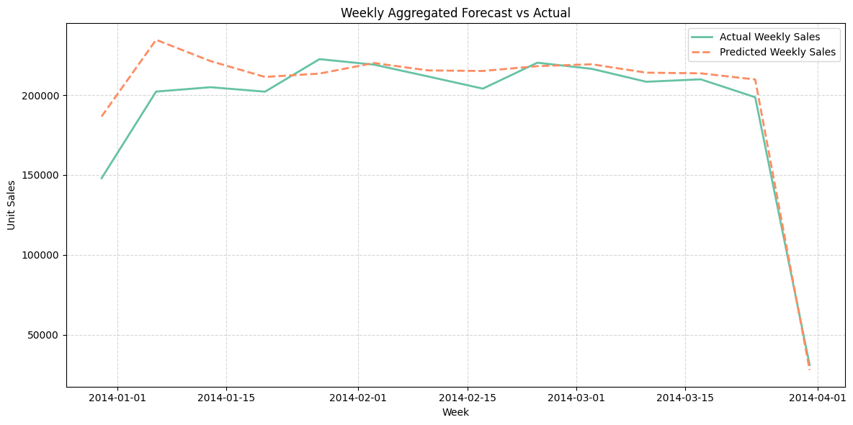
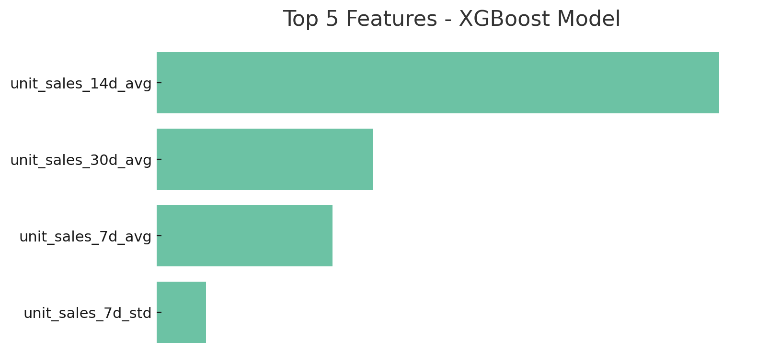
XGBoost Deep Dive
Why XGBoost Stood Out
Lowest RMSE (7.77) and lowest bias among all models
Effectively leveraged lag-based and rolling window features
Adapted well to sparse & skewed data (47% zero sales)
Weekly predictions aligned closely with true values
Transparent model: top predictors are interpretable
Donec risus dolor porta venenatis
Pharetra luctus felis
Proin vel tellus in felis volutpat
Molestie nec amet cum sociis
LSTM did not outperforming XGBoost dramatically.
Improvements could include tuning sequence length and feature selection.
Donec risus dolor porta venenatis
Pharetra luctus felis
Proin vel tellus in felis volutpat
Molestie nec amet cum sociis
Notes:
XGBoost stood out with the lowest RMSE and bias, meaning it was the most accurate and least skewed.
It handled the high percentage of zero sales well and leveraged lag features effectively.
Predictions tracked weekly trends closely, which is key for short-term operational planning.

Slide 7
Evaluation Metrics
Model | RMSE | MAD | SMAPE | Bias
XGBoost | 7.77 ✅ | 3.52 | 120.69% | 0.173 ✅
LSTM | 7.80 | 3.49 ✅ | 121.55%✅ | 0.195
SARIMA | 7.89 | 3.53 | 122.40% | 0.189
Key Takeaways:
XGBoost had the best RMSE and Bias → most accurate and least skewed.
LSTM achieved lowest MAD and SMAPE → most consistent error.
SARIMA performed well capturing seasonality, but had slightly higher errors overall.
Notes:
Let’s look at the metrics side-by-side.
XGBoost had the best RMSE and Bias, making it a top performer overall.
LSTM achieved the most consistent error, but didn’t beat XGBoost.
SARIMA lagged slightly in all metrics but offered strong interpretability.

Slide 8
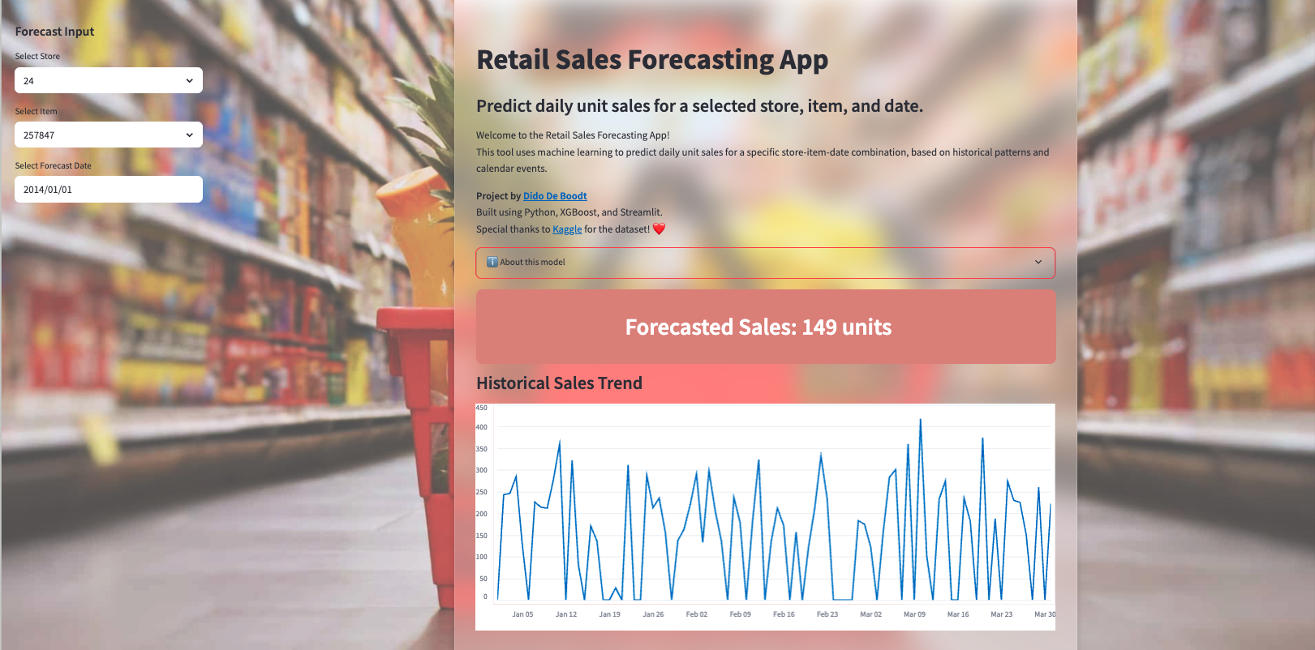
App Demo
Introduction
User Inputs
Prediction
Notes:
I built a Streamlit app where users can select a store, item, and forecast date.
The app displays an introduction, the forecasted sales,

Slide 9
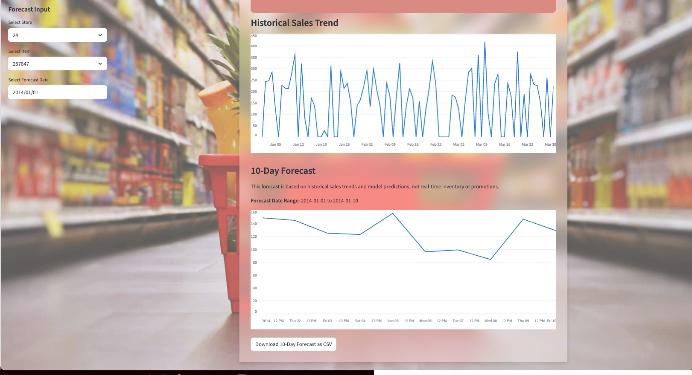
App Demo
Historical Sales Trend
10-Day Forecast
Notes:
historical trends, and a downloadable 10-day forecast.
This makes it accessible to non-technical users and supports decision-making for promotions and inventory.

Slide 10
Final Thought & Recommendations
Key Takeaways
Time-based features significantly improved results
ML models outperform classical ones
LSTM requires tuning & memory usage
XGBoost has best trade-off accuracy vs explainability
Recommendations
Deploy app to support demand planning
Automate updates and retraining
Explore Prophet or attention-based models like Transformers
Notes:
A few key takeaways:
Time-based features boosted performance significantly.
Machine learning models, especially XGBoost, outperformed traditional ones.
LSTM has potential with more optimization.
There’s always a balance between accuracy and explainability.
Next steps could include deploying the app more widely, automating retraining, and testing newer models like Prophet or Transformers.

Slide 11
Thank you for your attention!
LinkedIn
GitHub Repo

